Slide 1
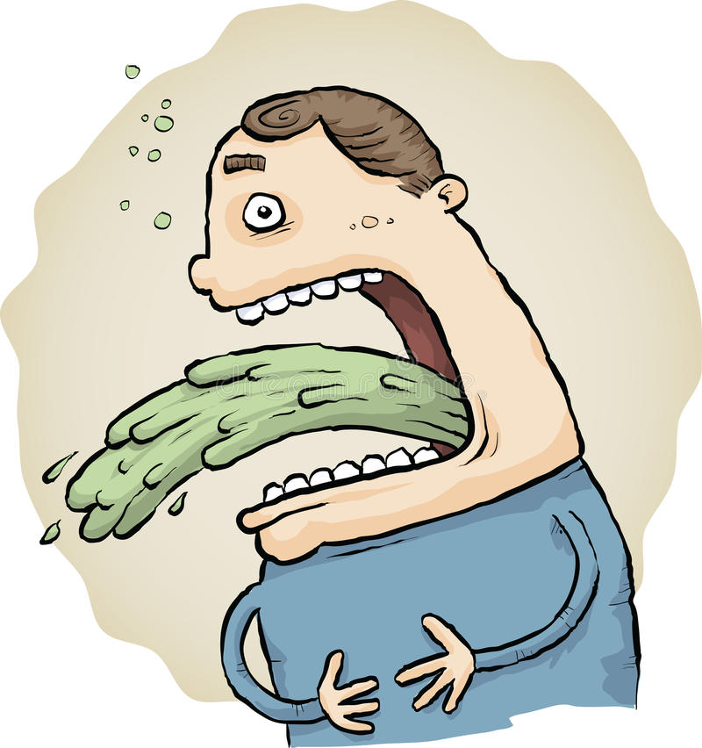
Vomiting: bringing up the contents of the stomach
Cause
Vomiting is a quick way of getting rid of unwanted bacteria in the upper digestive tract
The muscular walls of the stomach and small intestine contract, forcing the contents of the stomach up the oesophagus and out the mouth
Treatment
Drink clear fluids to remain hydrated, but small amounts at a time
Avoid solid food until vomiting stops and then eat light, bland food, such as crackers

Slide 2
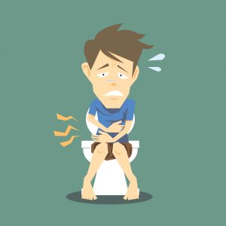
Diarrhoea: having frequent bowel movements with watery faeces
Cause
Diarrhoea is a quick way of getting rid of harmful bacteria in the lower digestive tract
The lining of the intestine becomes inflamed and can no longer absorb water from faeces
This results in watery faeces
Treatment
As the body is not absorbing water, people with diarrhoea are at risk of dehydration
Drinking plenty of fluids will prevent dehydration

Slide 3
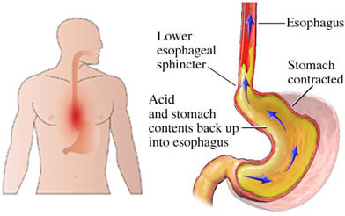
Heartburn: burning sensation in the chest
Cause
Heartburn is a burning sensation rising up from the stomach into the oesophagus
It is caused by stomach acid rising into the oesophagus
The stomach acid attacks the walls of the oesophagus because there is no mucus lining to protect it
Treatment
Antacids, in the form of liquids or tablets, are medications that neutralise stomach acid
Lifestyle changes, for example a change in diet, avoiding large meals and lying down after a meal can help persistent heartburn

Slide 4
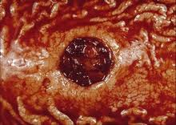
Stomach Ulcers: open sores in the stomach lining
Cause
The acid in the stomach eats away at the tissue around the ulcers causing pain
Two Australian scientists, Marshall and Warren, proved that ulcers are caused by a bacterium called Helicobacter pylori
Treatment
Stomach ulcers can be treated using antibiotics, which kill the bacteria that causes them
Before the discovery of the bacterium causing them, ulcers were treated by a change in diet or reducing stress

Slide 5
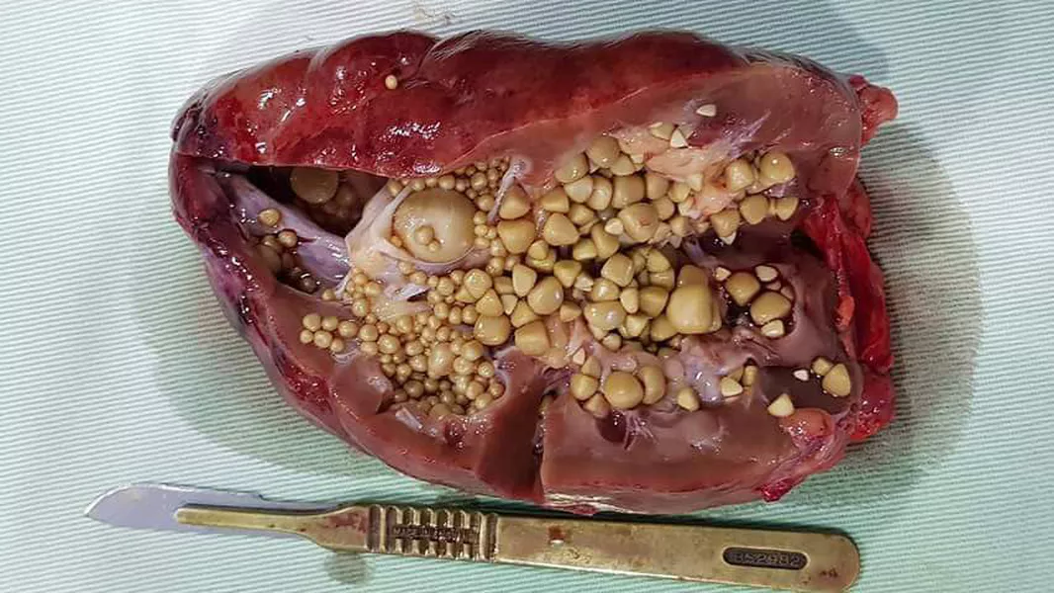
Gallstones: small masses in the gall bladder
Cause
The gall bladder stores bile produced by the liver
Bile can harden into small stones that stop the bile leaving the gall bladder.
This makes the gall bladder swell and causes pain
Treatment
Sometimes gall stones can be shattered using ultrasound or can be removed by surgery
Occasionally, the gall bladder is removed, but this means the person may have trouble digesting fats and oils

Slide 6
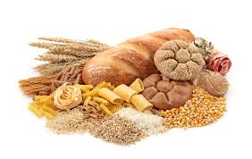
Gluten Intolerance: inability to process gluten in food
Cause
Gluten is a small molecule found in grains and cereals
Some people don’t produce the enzyme needed to chemically digest gluten
People who are gluten intolerant can have a range of problems, including blockage of the intestines, bloating and diarrhoea
Treatment
People who are gluten intolerant avoid foods containing gluten
Some people may also take dietary supplements containing the missing enzyme

Slide 7
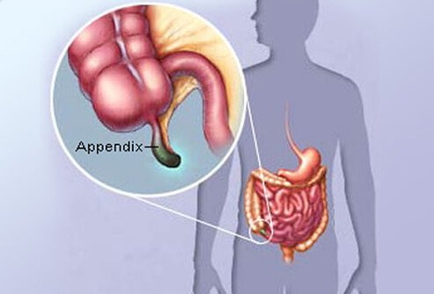
Appendicitis: an inflammation of the appendix
Cause
The appendix is a blind ended tube connected to the large intestine
If the opening gets blocked, it fills with mucus and becomes inflamed and swollen.
This inflammation can cause a lot of pain
Treatment
The only treatment is an operation to remove the inflamed appendix before it bursts and causes a more severe infection

Slide 8
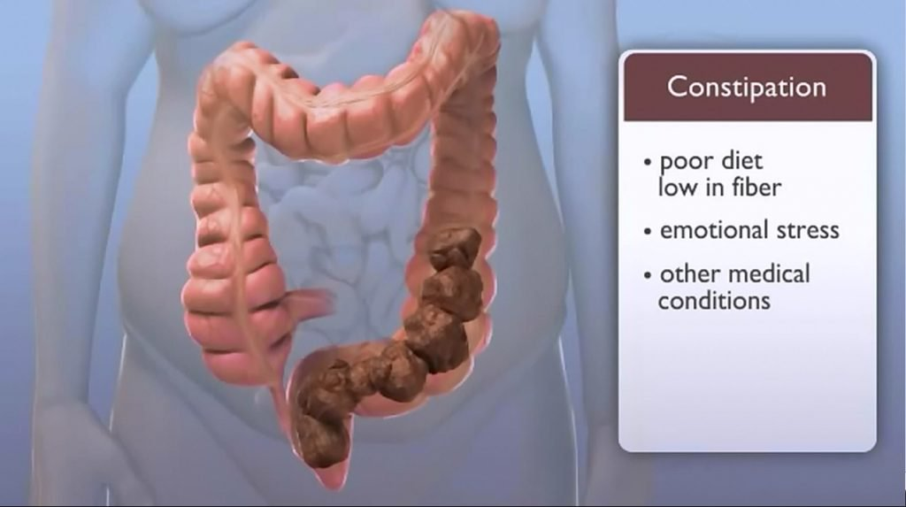
Constipation: blockages of the intestine
Cause
Blockages of the intestines can be caused by poor diet (lack of fruit and vegetables) or infections
Small blockages increase in size as more food moves through the digestive system, gradually filling the large intestine
This causes pain and discomfort
Treatment
A change in diet to include more fibre from fruit and vegetables can help prevent constipation
People can take laxatives, which are medications that help food move through the intestines easily
For large or prolonged blockages, surgery may be needed to remove the blockage

